Slide 1
How to make your elementary school homework more fun with python
Matthew Mirvish

Slide 2
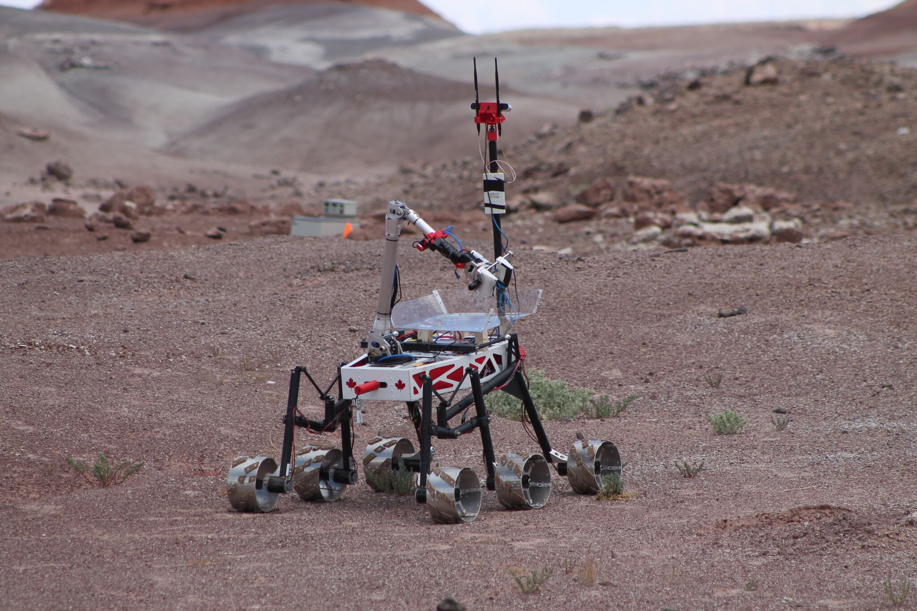
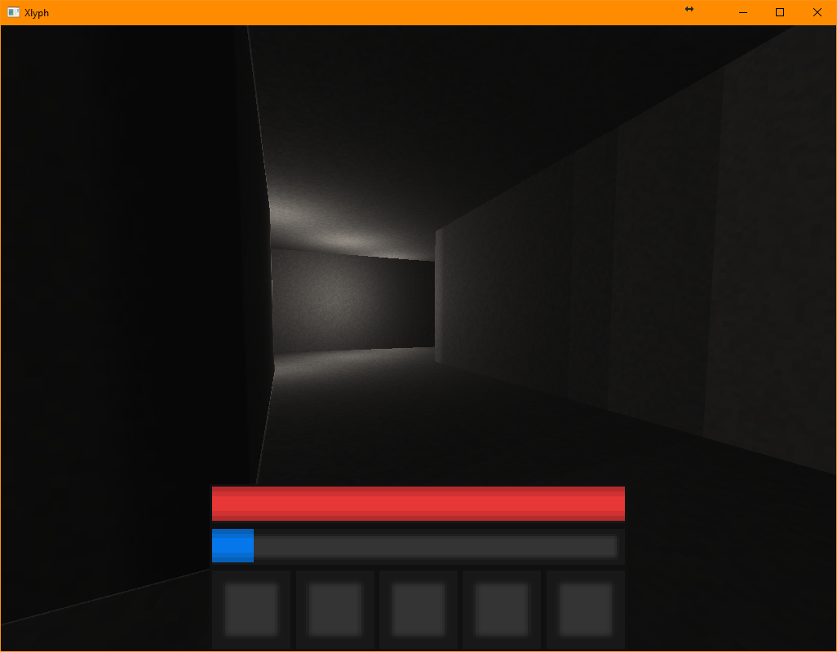
Who am I?
Notes:
So who is this person talking to you?
I’m Matthew, and I do a lot of things in my spare time. When I was rather young, I learned how to program and know I use that knowledge to do things like program mars rovers for teams at Ryerson University, make fun computer games, but I have a bit of a chronic problem of

Slide 3
I end up automating my annoying homework.
Notes:
automating my very annoying homework.
This talk is going to contain a bunch of examples of this, and hopefully along the way tell you some interesting things about python. Or maybe its libraries. Or maybe you’ll just go WTF at why I’d ever write some of this stuff. Or maybe you’ll learn something about how not to automate things,

Slide 4
I’ll show a small example of this:
Notes:
So we’re going to start small here, and let’s see one of the first things I did in grade 7:

Slide 5
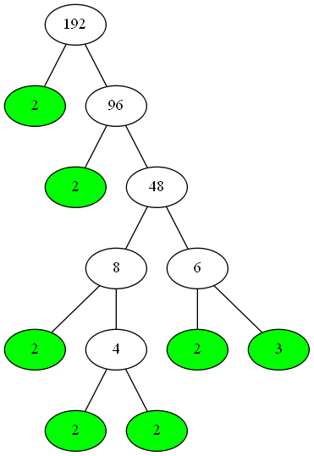
Factor trees
Supposed to “help” make finding prime factors easier.
Useful, but not when you have to do literally 50 of them.
Here’s an example of one →
You essentially do repeated division down to primes, and apparently this always gives you the prime factors.
Notes:
Factor Trees.
These “helpful” mathematical devices are supposed to make finding prime factors easier. Sure, they might do that for a bit, but once you have to come up with hundreds of them, it gets a bit grating…
Here’s an example of a simple one, and if you haven’t already worked it out, you just do repeated division until you get only primes.
That’s nice and all, but again, after doing 3 or 4 and seeing your homework for the day,

Slide 6
That gets rather annoying.
Notes:
it gets a bit annoying.
As such, I decided to automate this, in fact that image you just saw was produced by this program.

Slide 7
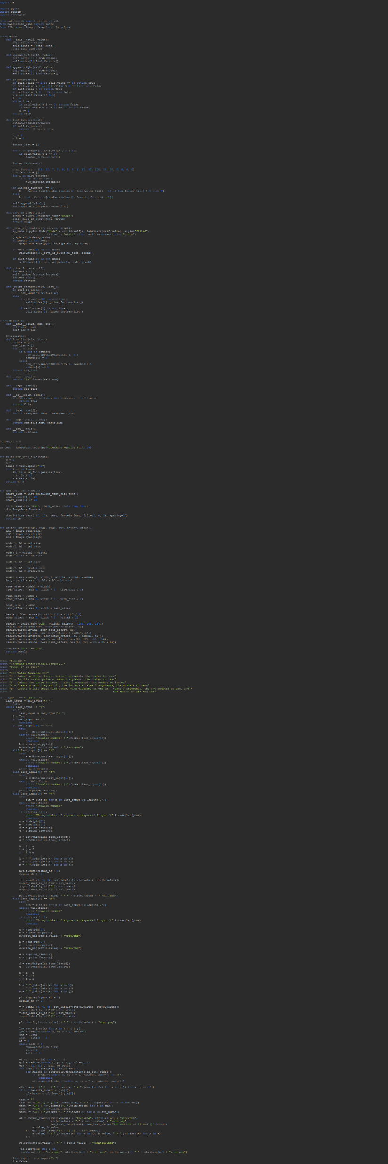
c1_3.py
This is the source code of that program.
You may of noticed it’s a bit long.
Notes:
This is that program’s source code.
You might of noticed its just a bit long. Just maybe a bit too long.
It works by:

Slide 8
It works by
Creating a class that represents one number on the tree, and has a function that returns any children as necessary.
Piping that data into pydot to create a graph.
Taking two of those, saving them to disk, re-opening them in PIL to create two side-by-side
Using matplotlib-venn to create another image, reopening that in PIL to stitch that in
Using PIL again to write some text, and finally saving an image.
might be a bit overcomplicated
might….
Notes:
Creating a class that represents one number on the tree, and that class has a method that returns any children recursively as necessary.
Piping that data into pydot to create a graph. (pydot is a pretty cool thing for making flowcharts and diagrams, but it’s been massively misused here!)
Taking two of those, saving them to disk, re-opening them in PIL to create an image with two side-by-side for comparison
Using matplotlib-venn to create another image, reopening that again in PIL to stitch that in.
Using PIL again to write some text, and finally saving an image.
It might be a bit overcomplicated.
Might…

Slide 9
Don’t overcomplicate things
trivial
^
Notes:
Of course, I can give you one important lesson here which is to not overcomplicate things.
I don’t mean spending 10 hours working out an architecture that makes your code simple, I mean things like not obsessing over how your output looks

Slide 10
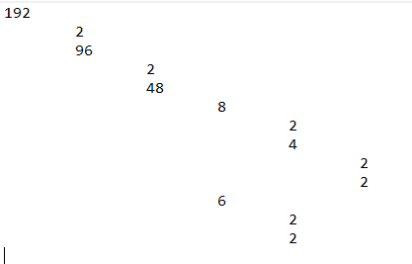
Factor trees
Supposed to “help” make finding prime factors easier.
Useful, but not when you have to do literally 50 of them.
Here’s an example of one →
You essentially do repeated division down to primes, and apparently this always gives you the prime factors.
Notes:
For example, although the output of the program I wrote looked nice, it also required about an hour of tracking down obscure binaries and configuring environment variables for it to work.
The output still would of looked just as fine if I had just done this though:

Slide 11
Factor trees
Supposed to “help” make finding prime factors easier.
Useful, but not when you have to do literally 50 of them.
Here’s an example of one →
You essentially do repeated division down to primes, and apparently this always gives you the prime factors.
Notes:
Doing it this way would have been much simpler, and the venn diagrams could have been made with simpler text representations too, removing dependencies for a script that really shouldn’t have any.

Slide 12
What about the “more fun” part?
Notes:
Still, you might be wondering:
Why is the talk called making your homework more fun?
Well……

Slide 13
“all about me”
My laptop was running linux and didn’t have powerpoint
Slideshow with ~10ish slides about yourself
Graded on use of powerpoint and English.
Notes:
So
We had a project where we had to create a presentation about ourselves (slide), and it was graded on the powerpoint and English and things like that. (slide)
I had one slight problem: (slide) I didn’t have powerpoint on my laptop

Slide 14
Solutions
Fix my windows install
Give in and use the school computers
Do it on a different computer
All bad ideas
Notes:
There were multiple solutions, of course:
Fix my install of windows
Use the beige boxes they say are “modern” to do it
Just do it on my other computer at home.
Unfortunately, (slide) those are all terrible ideas.
Instead, I decided

Slide 15
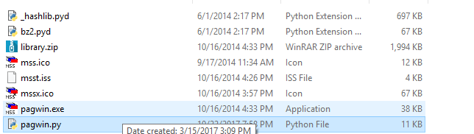
Notes:
to use the power of the program currently in this directory. What was it called?

Slide 16
MSS Matthew Slide System
™
Notes:
It’s MSS, the Matthew Slide System. ™ (DON’T FORGET TO DO ANIMATION)
So….
What could it do?

Slide 17
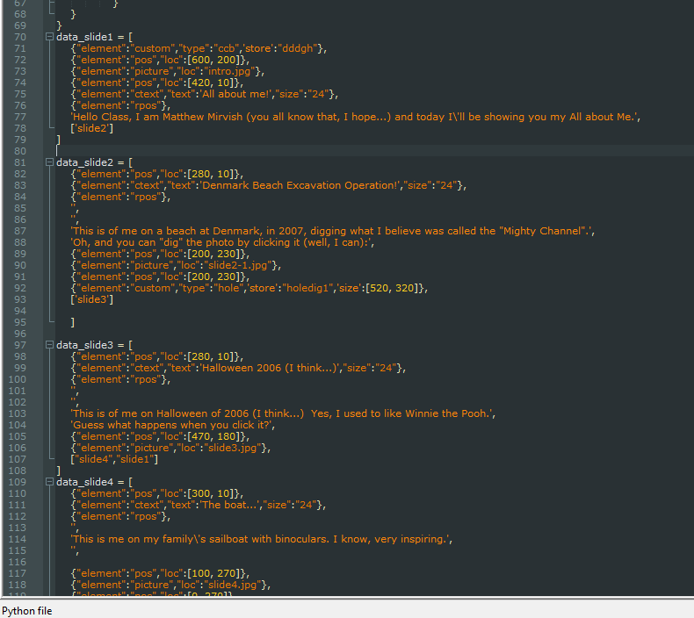
“Features”
Create captivating slideshows
Use the intuitive syntax of python files
Have complete control over what the software does
Notes:
This program had _tons_ of features, such as:
(in slightly silly commercial tone)
Create captivating slideshows
Use the intuitive syntax of python files
I’m serious about that, you literally defined the entire thing as a python file that’s inserted into the main program executable. (hide)
and Have complete control over what the software does

Slide 18
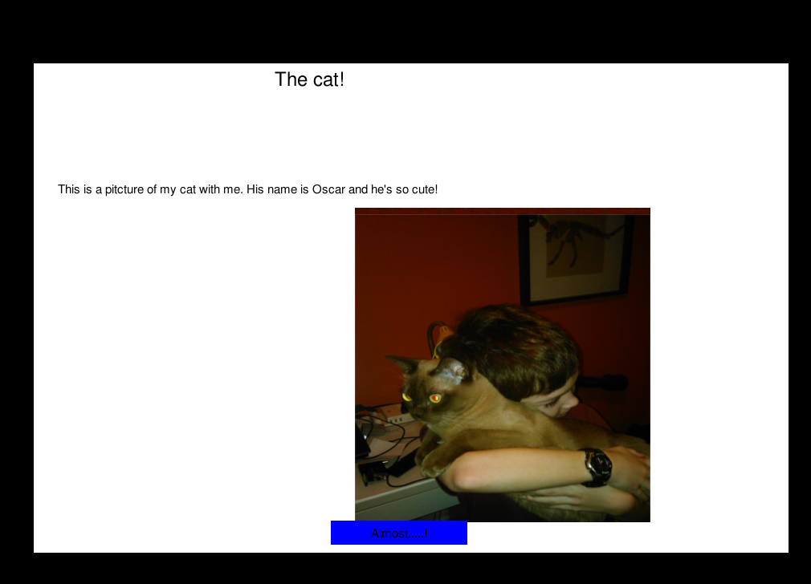
Surprisingly, it worked!
Notes:
Surprisingly, it actually did work!
(you can also see how happy my cat was to be in this presentation)

Slide 19
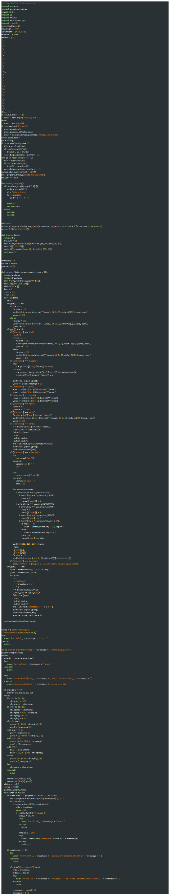
How did it’s insides look?
Surprisingly, not that bad.
Still, with the whole “python file as input”, there’s a pretty generous amount of eval-ing,
Notes:
So how did the code look?
(slide)
Suprisingly, not that bad
(slide)
I mean, considering the amount of “dynamic magic” it uses, there’s a pretty generous amount of “evals”. A lot of these things could’ve been done with simple getattrs or dictionaries though.
But, the question is: what mark did it get?

Slide 20
4
Notes:
Well, I got a Level 4 on it. …actually no I (slide)

Slide 21
4-
Notes:
got a four minus.
(anim)
MINUS!
Anyways, next on our tour through crazy school projects we get to

Slide 22
Classroom Economy
You would get jobs in the classroom
I got “webmaster”
Normally you’d make some blog….
A bad idea
Notes:
Classroom Economy, which was a half-hearted thing meant to teach you how to adult.
(slide)You would get classroom jobs, like janitor, energy monitor or webmaster
(slide)Guess which one I got
The normal thing you’d do for this job is put up some blog (slide), but you’ve probably figured out by now that those are again, (slide) all bad ideas.

Slide 23
Make one from scratch
Notes:
The correct solution, of course, is to write a (slide) glorified CMS from scratch.
I mean, there were (slide)

Slide 24
Advantages
Excuse to do programming in class
Ability to create a classroom economy “business” out of ads on the site
MORE FUN!
Notes:
some advantages, like being able to do (slide) programming in class, or
(slide) charge people fake money for ads, but mainly it was(slide) more fun

Slide 25
Did it work?
Notes:
Now the question is “did it work?”
The answer, is

Slide 26
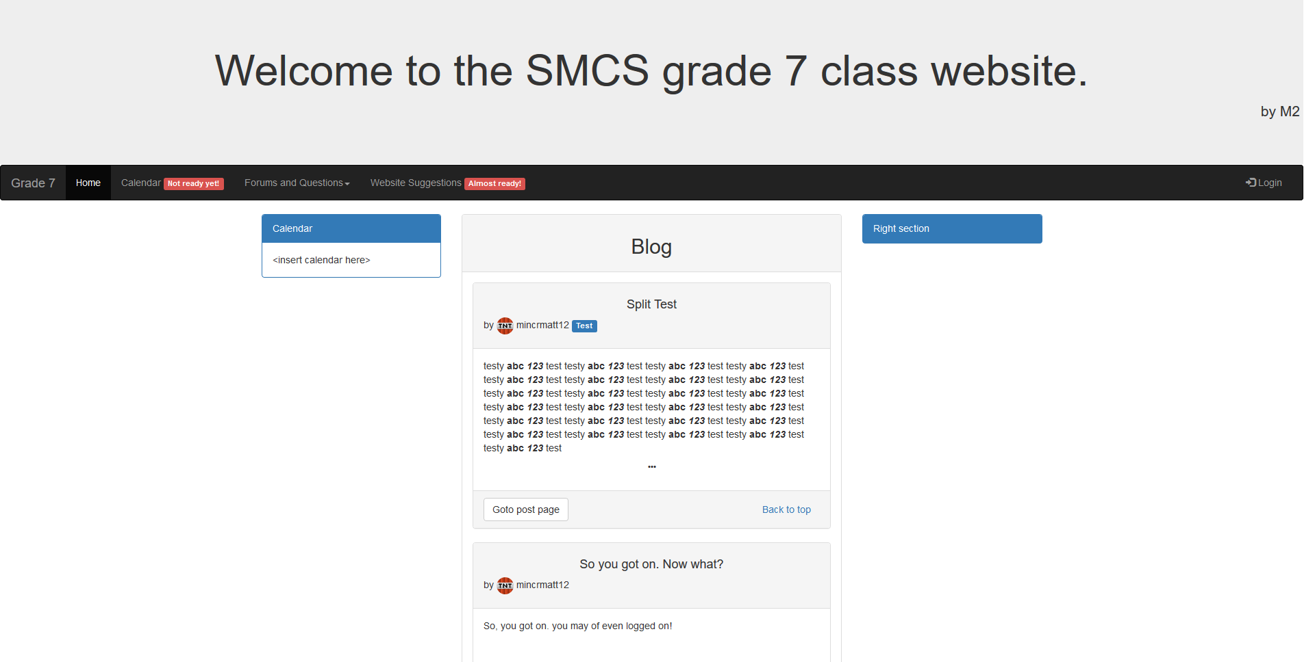
Yes, yes it did
Notes:
Yes, yes it did.
This was the homepage,

Slide 27
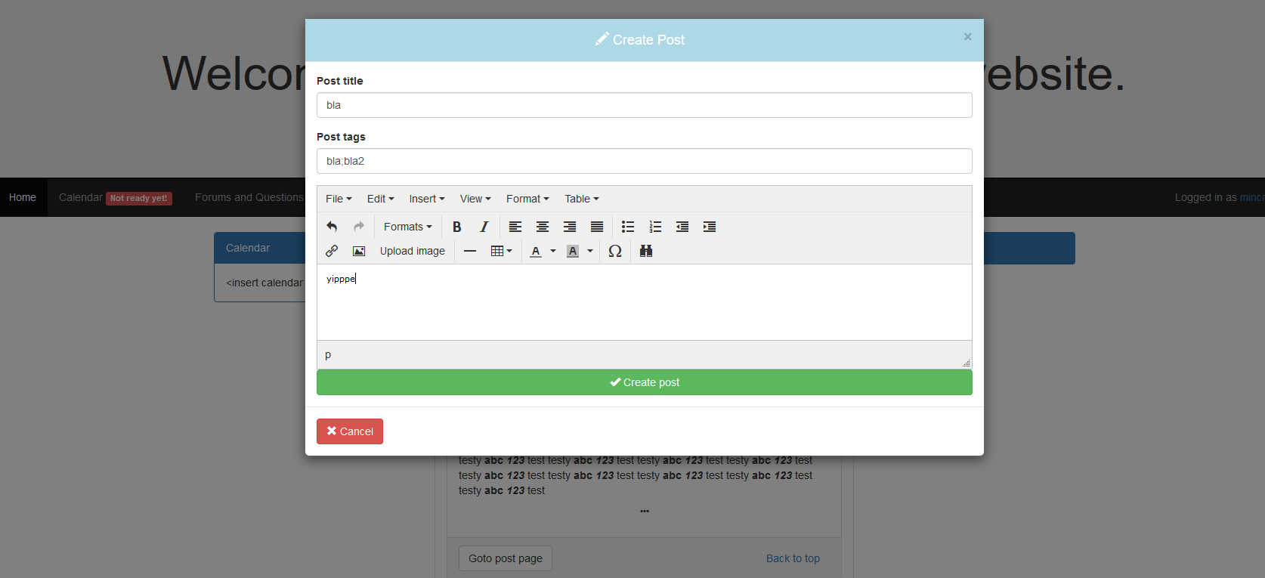
It was fairly full-featured!
Notes:
here is where you could post things,

Slide 28
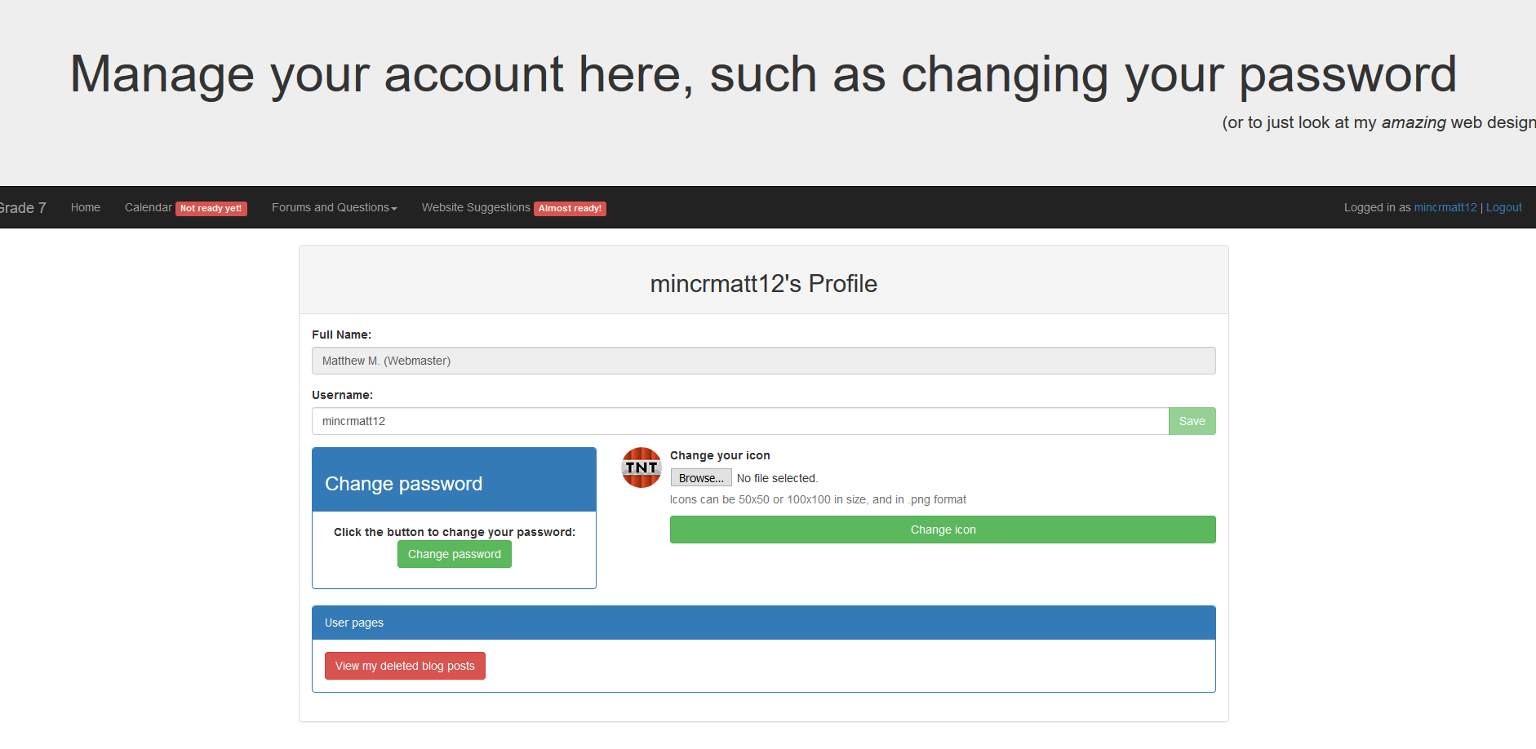
It even had an account page
Notes:
this is where you could change things about your account!

Slide 29
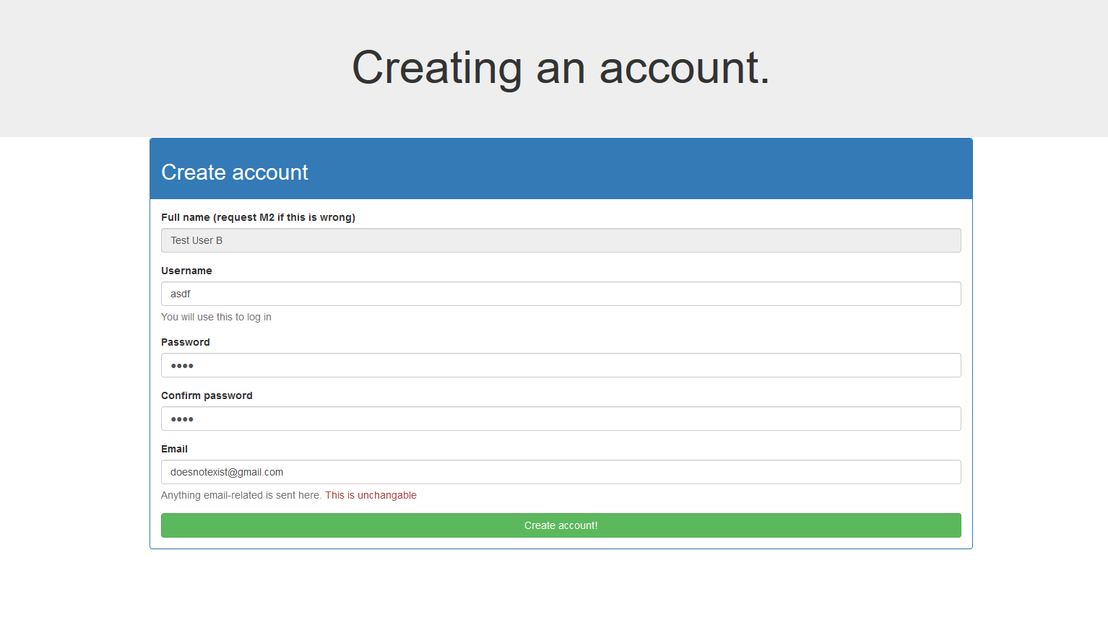
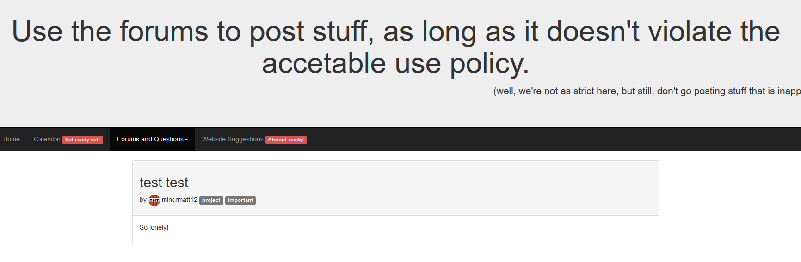
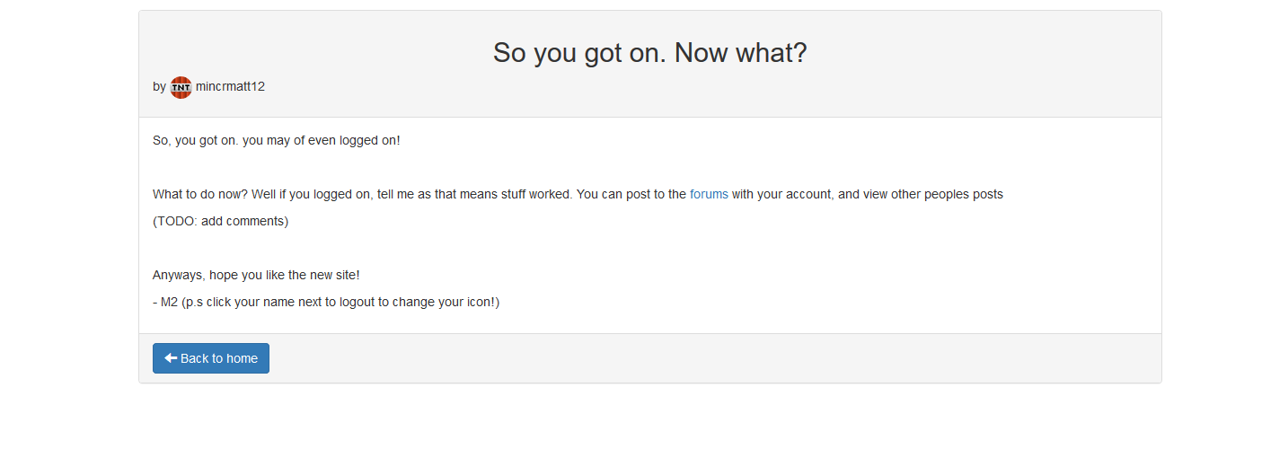
More screenshots
Notes:
And here’s a few more screenshots.

Slide 30
This isn’t live anymore
Notes:
Also this isn’t live anymore, btw

Slide 31
What about the code?
This one has a lot of code in it
Here are some gems from in it:
Notes:
So, what about the code?
(slide)So, this is one of the bigger school-related projects,
So instead of looking at it all in summary, here are some gems from within it (slide)

Slide 32
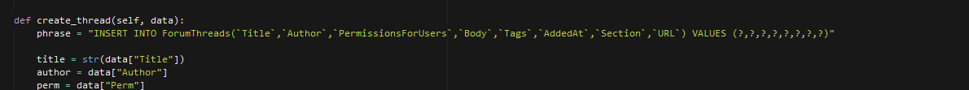
Raw SQL
Notes:
This code is also from before I learned to use an ORM for big things like this.
Atleast it didn’t have SQL injection!

Slide 33
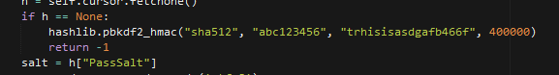
“abc123456”
Notes:
In a feeble attempt to prevent timing attacks, this is what happens if you type an invalid username.

Slide 34
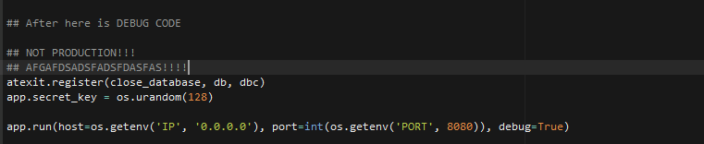
NOT PRODUCTION
Notes:
Although comments of the previous matthew were rare, they often added little value. I counted, this is one of about 5 comments in the entire codebase

Slide 35
Success of project?
In total, I saw all of…
3 times it ever got used. ☹
It also never got finished, as you may have been able to tell from the pictures.
Still, it was a fun project and was a great distraction from class!
Notes:
So, how did this project of mine go?
Well, (slide) in total, I saw
(slide) 3 people use it.
So, maybe not very successful as an actual website, and due to this (slide) it was never really finished either.
Still, (slide) it was fun to do, and did make a great distraction to classwork!
Anyways, the last (and best) thing I’m going to show you is….

Slide 36
Landscaping Project
Design a backyard out of the school yard
Come up with costs
Make a 3D model of it
Notes:
The (anim)LANDSCAPING PROJECT
(yes I know the name just fills you with anticipation)
So in this project we had to design (anim) a backyard that would fit in the the school’s playground area.
We also had to make a 3D model (anim), and come up with costs (anim).
Of course, the only thing I care about is the (anim) 3D model.

Slide 37
Choices
Minecraft
Blender (or similar modeling tool)
CAD
All bad ideas
Notes:
So what could I use to do this?
Well, I could use a game like Minecraft (anim), maybe use something a bit nicer like Blender to do a model, or CAD it with some other tool.
But, as is the trend with these slides, those are bad ideas.
Why? Well everyone knows that playing a computer game for educational purposes isn’t fun! Want to know what is fun? Using a slightly arcane C API (in python, of course) from 2002 to create 3D by hand! That’s where the fun’s at!
So, what came out of this endeavor ? (slide)

Slide 38
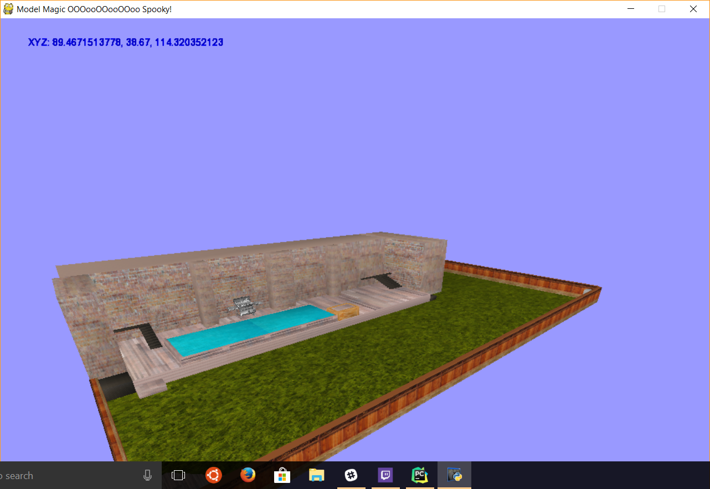
3DLandscapeModel
Notes:
3DLandscapeModel did.
The most beautiful 3D engine known to mankind ☺

Slide 39
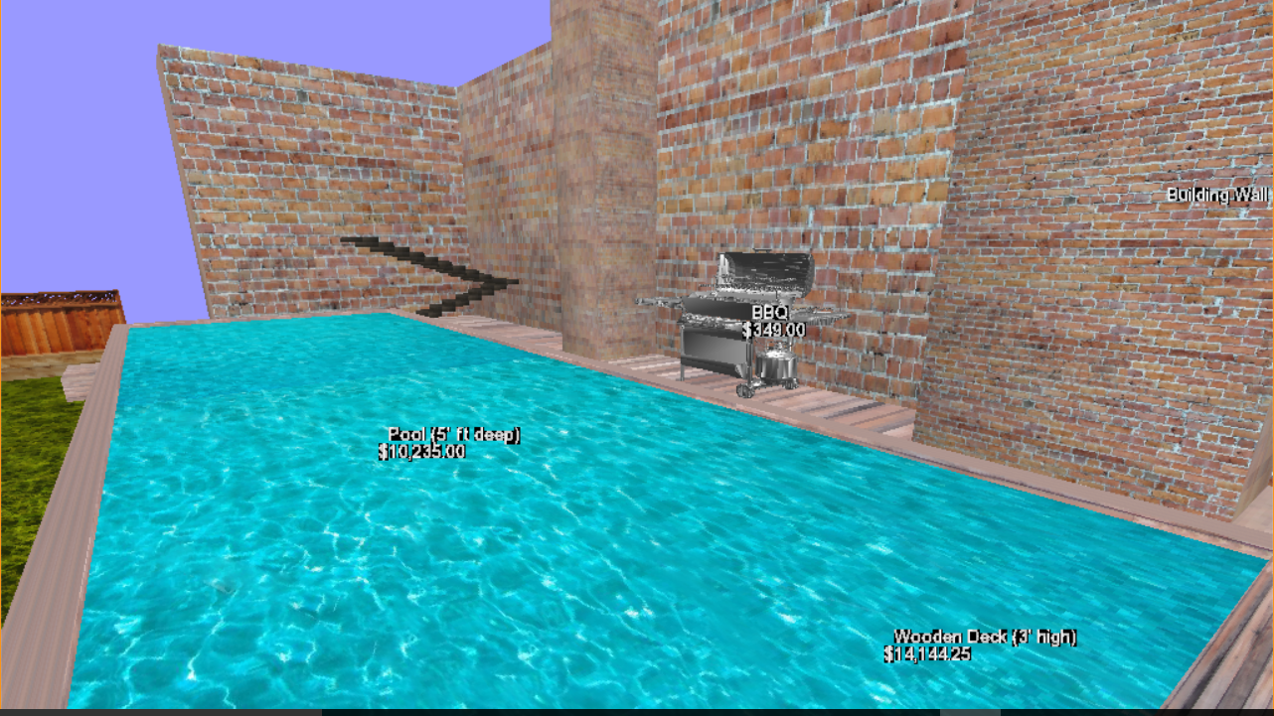
Features
It’s free!
All information is in the easy format of JSON
Custom scripting language built-in for ease of extra features
3 superb kinds of geometry: box, extrude and obj
A collision system inspired by a 20 year old game
Notes:
So, what could it do?
Well, unlike some solutions it was free, (anim)
There was no need to learn some fancy editor, all you needed was a notepad file (anim)
A fully custom scripting language (Anim)
3 AMAZING ways to define geometry: boxes, extrudes and obj files! (anim)
And a collision system based of Super Mario 64. (anim)

Slide 40
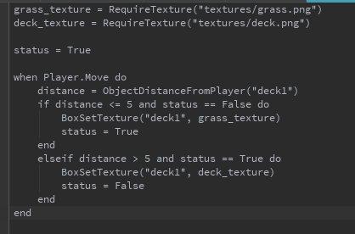
Custom scripting language?
Notes:
But wait? Custom scripting language?
Yup! (anim)
It was written (slide)

Slide 41
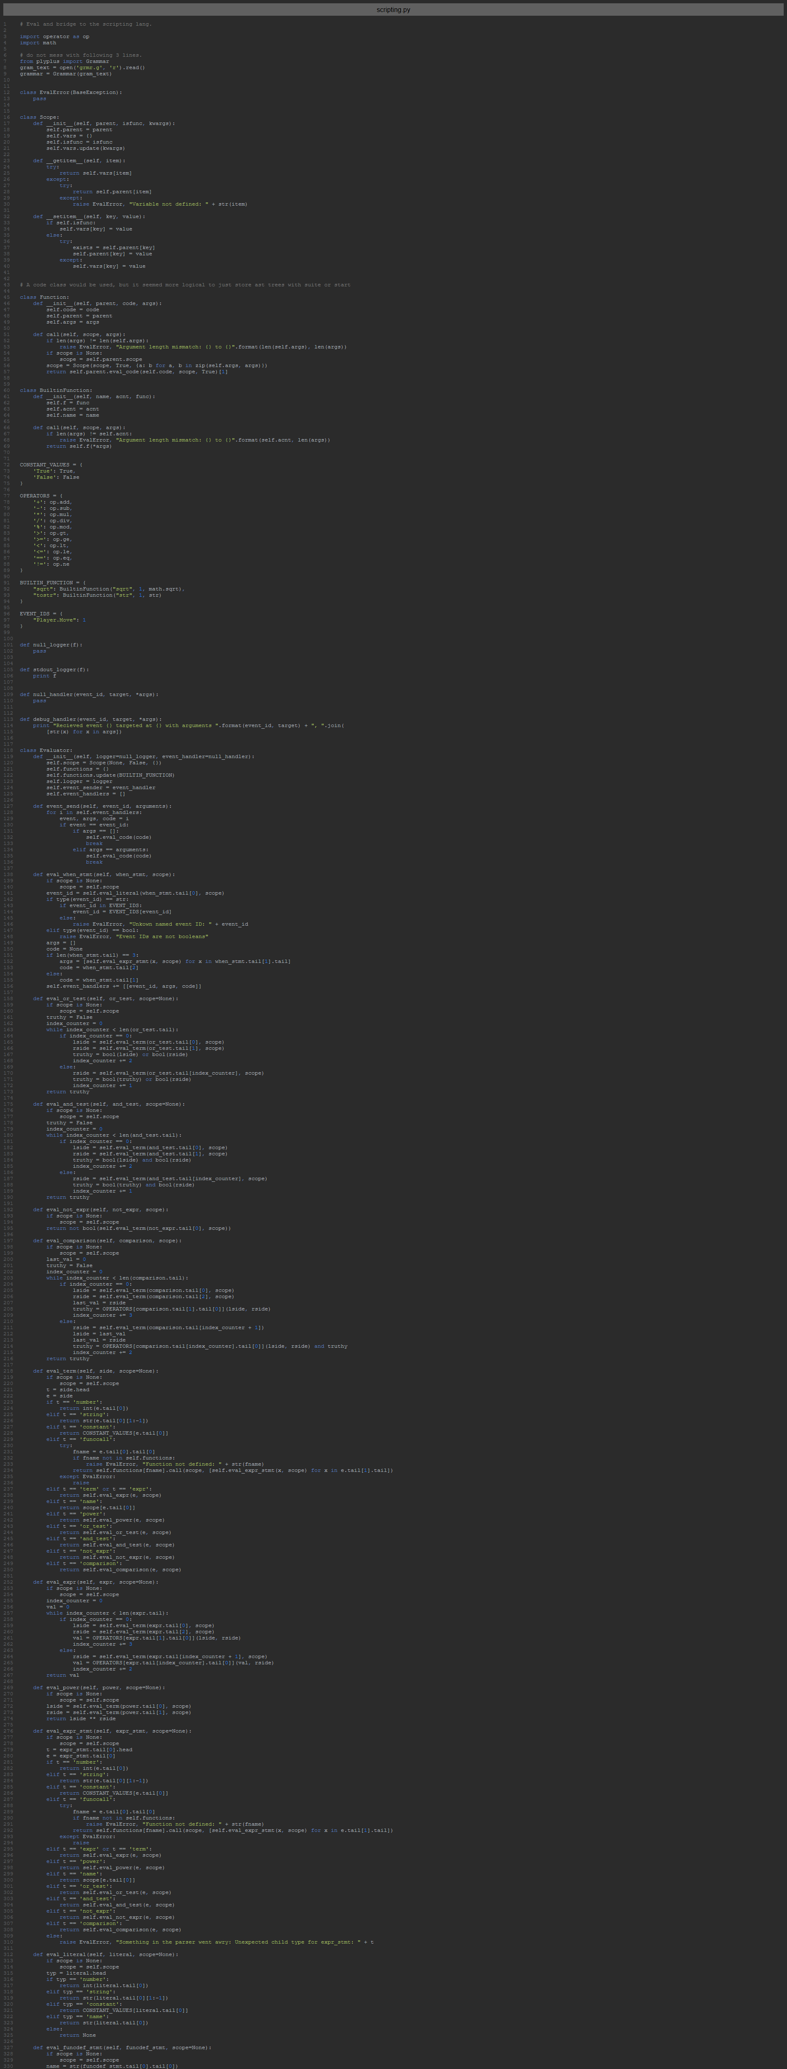
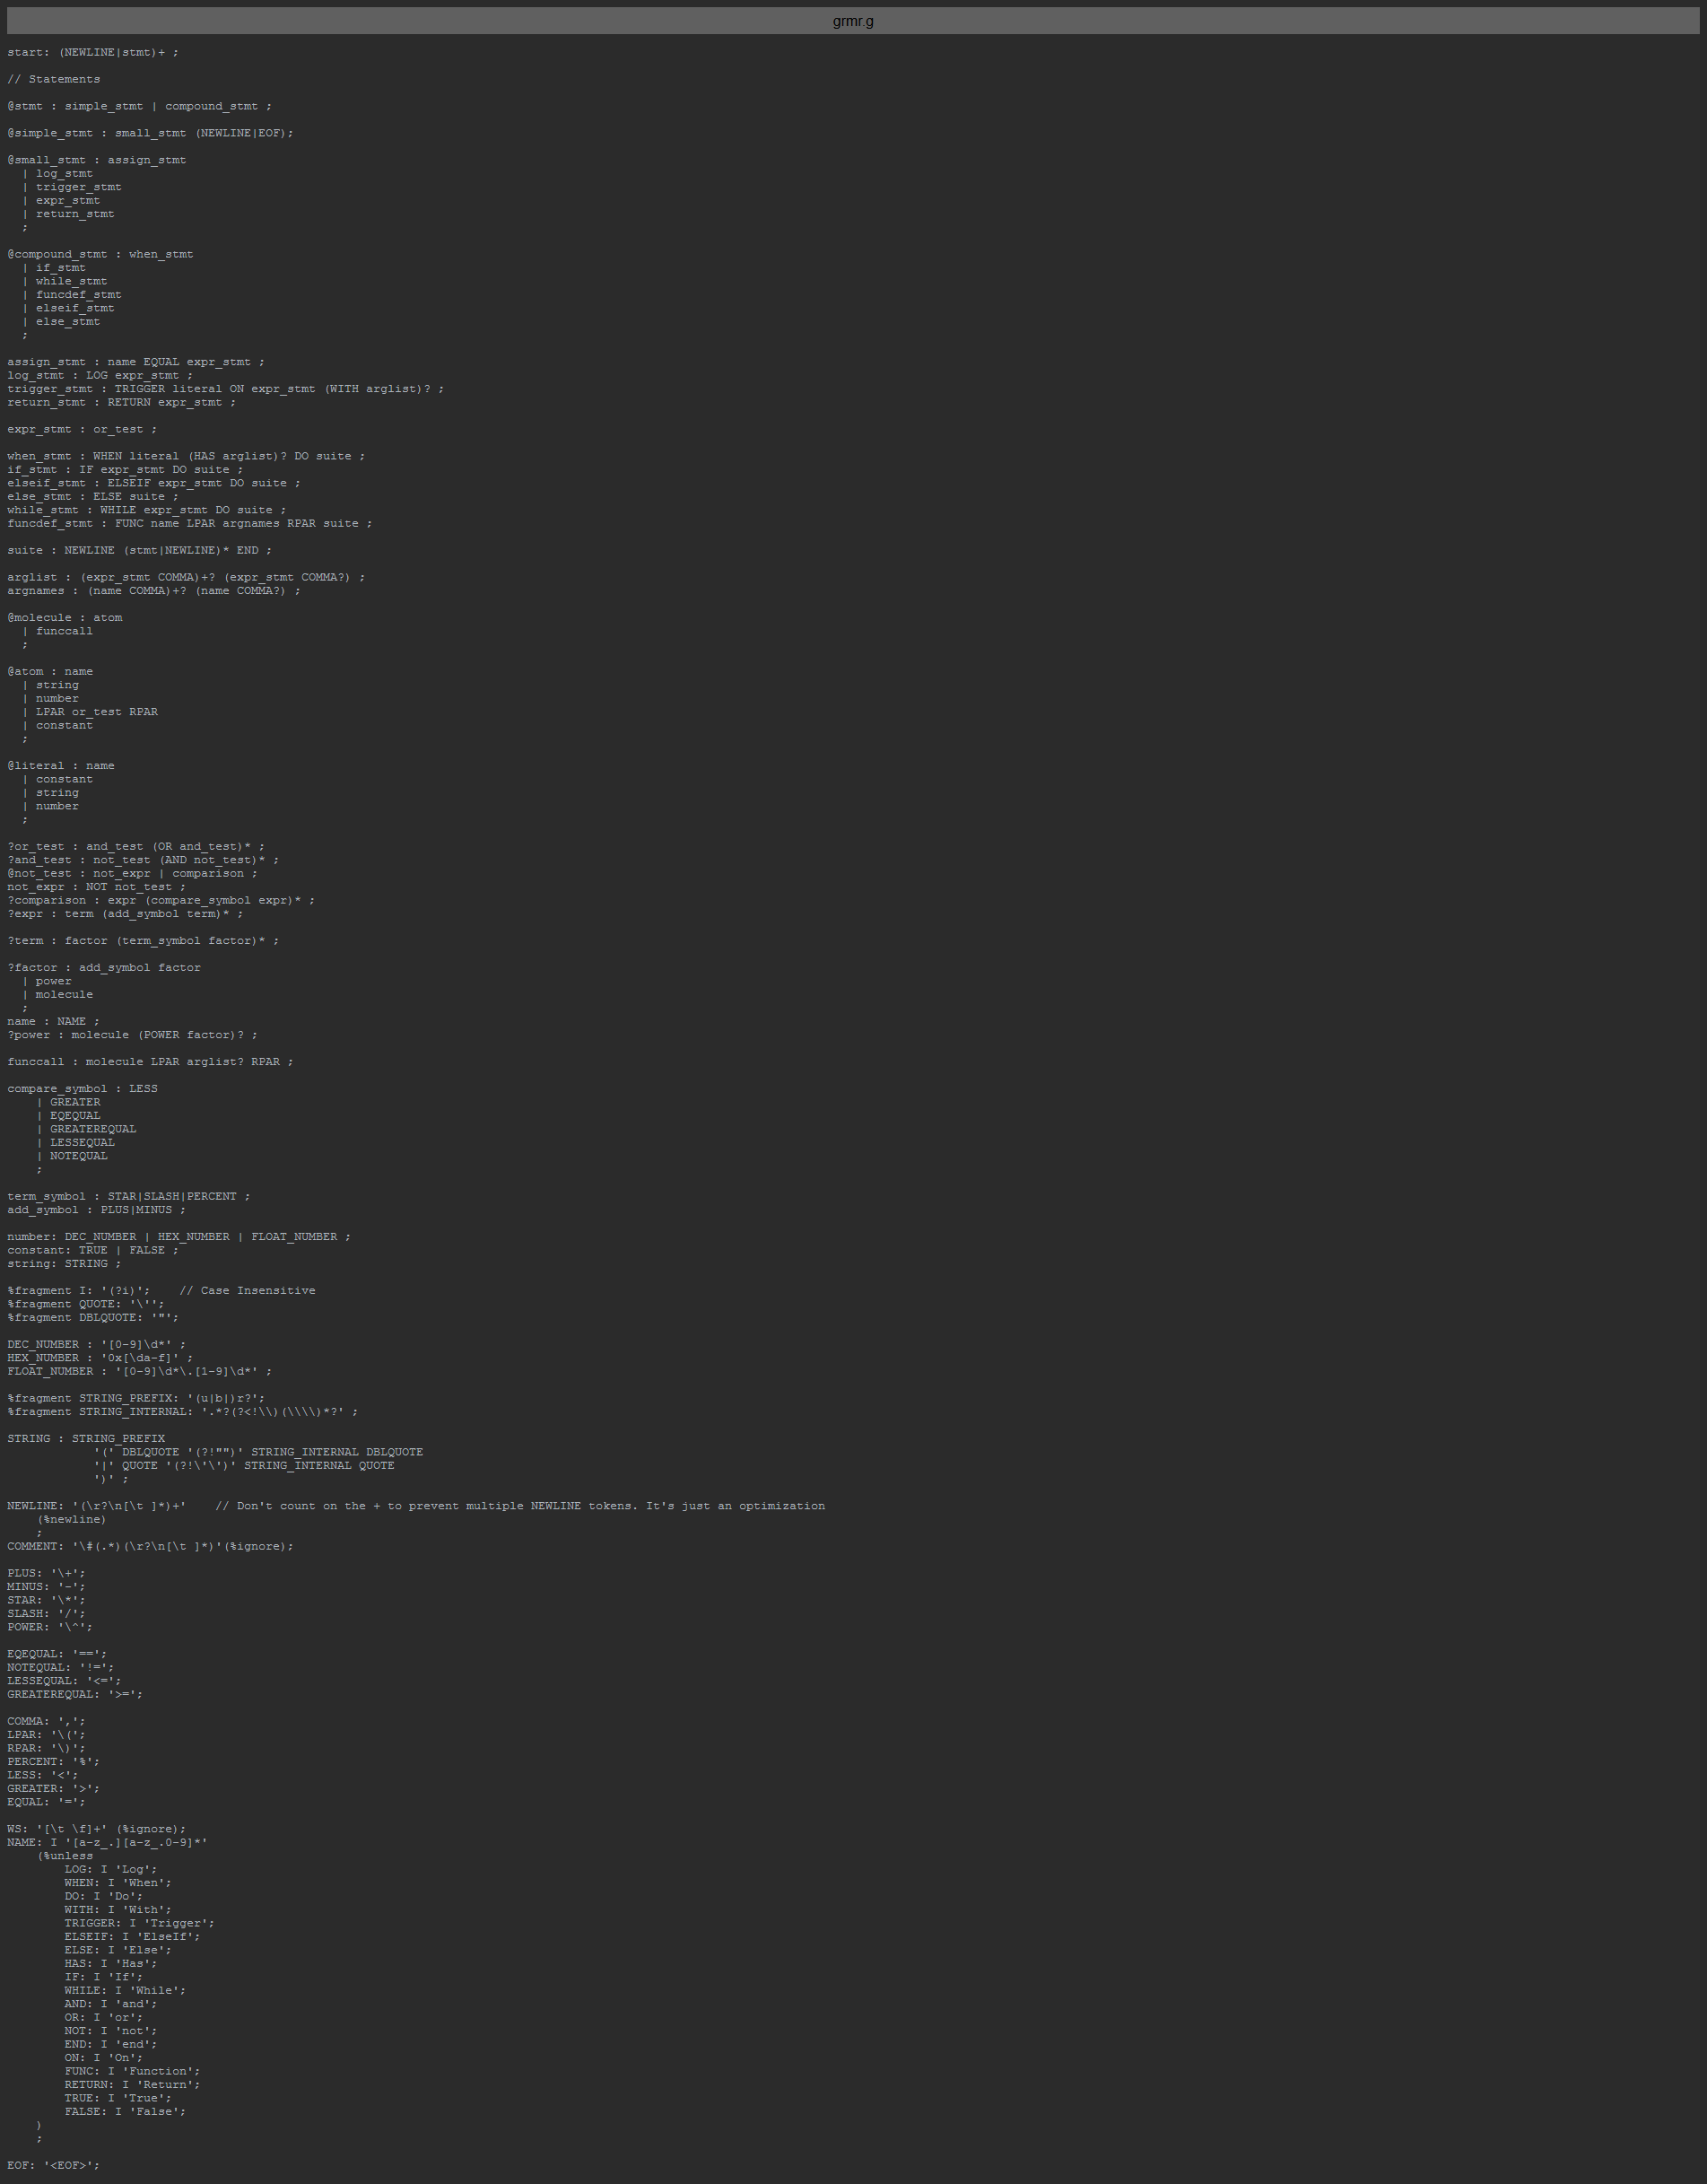
In over 450 lines of python
Notes:
In over 450 lines of python, it parser MatScript! (working title)
I did use a parser generator though
My favourite bit of code in this program, though, has to be this:

Slide 42
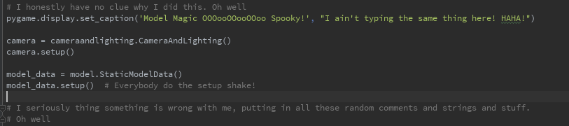
Model Magic OOOooooOOO Spooky
Notes:
This is like line 20 of the main file.
It starts with setting the window title to “Model Magic OOOoooOOO (good choir noise here) Spooky”.
It has a great comment of

Slide 43
Model Magic OOOooooOOO Spooky
Notes:
# I have honestly no clue why I did this.
Oh well.
But it gets better:

Slide 44
The setup shake?
Notes:
Only like 5 like lines afterwards, on the bit of code that compiles the GPU display list to draw everything, there’s a comment that says
“Everybody do the setup shake!”
I forgot about this when I was reviewing the code for this presentation.
Previous matthew also thought these comments were strange, because 2 lines after is this:

Slide 45
Notes:
I seriously thing something is wrong with me..
I promise I didn’t add this just for this. In fact,

Slide 46
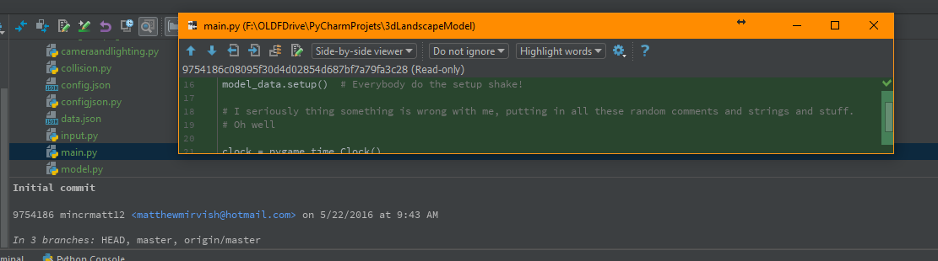
Notes:
In the initial commit, in MAY (anim) of LAST YEAR (at 9:43 AM), this was added along with the rest of the comments.

Slide 47

Let’s actually run it!
Notes:
So: let’s actually run the program because you need to see the crazy that is 3dlanscapemodel.
(also random design idea from office!)

Slide 48
That’s it!
Notes:
And that’s the end of my talk!

Slide 49
That’s it!
If you want to stalk me on github go to:
https://github.com/mincrmatt12
All the code presented today (as well as some that didn’t make it) are going up in about 30 minutes, along with some vague instructions on how to run them
Thanks for coming to my talk!
Notes:
If you want to find me on github, (anim) then go to there (anim).
If you want the code shown today, once I properly finish I’ll be making the repo public there, (anim) along with some maybe useful info on how to get them running,
And of course, (anim) thanks for coming to my talk!

Slide 50
End of slideshow, this slide is here so that there are a perfect 50 slides in the deck!

